Slide 1



SOFTWARE DEVELOPMENT PROFESSIONAL PROGRAM
Routing: Finding Your Way Around

Slide 2





Routing: Finding Your Way Around
Learning Objectives
Describe a reason someone might use an environment variable.
Demonstrate the ability to create multiple routes.
Utilize query parameters within routes.

Slide 3

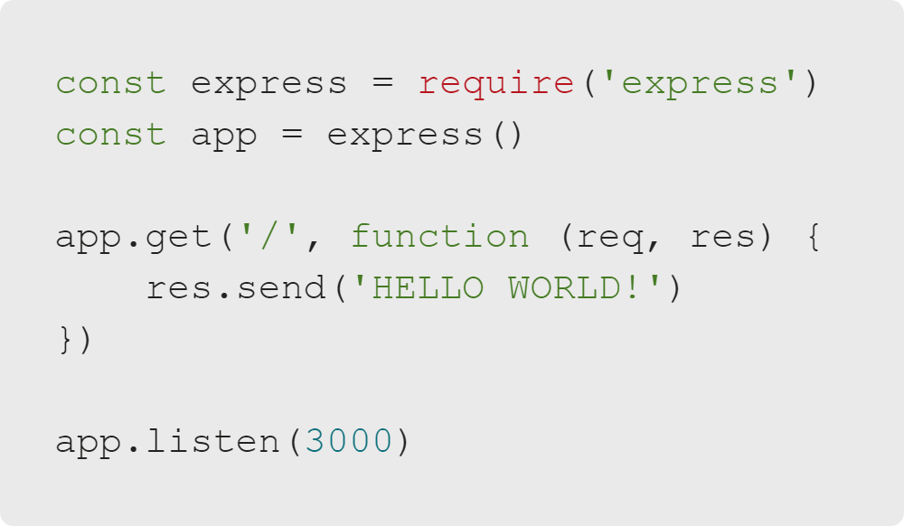
Routing: Finding Your Way Around
Review: Express
A simple app that really works
We made a simple Express app.
Let's take it to the next level!
Notes:
In the last lesson, we learned how to make a bare-bones Express app.
Let's take it to the next level by adding some new concepts like global variables and more pages!

Slide 4


Routing: Finding Your Way Around
Environment Variables
Environment variables are useful! They:
Avoid hard-coded data in code.
Protect private data like API keys.
Abstract machine-specific settings (like your choice of port).
Tip: Environment variables are typically written in all caps, like constants.
Notes:
Do Lesson Companion Exercise 1.

Slide 5
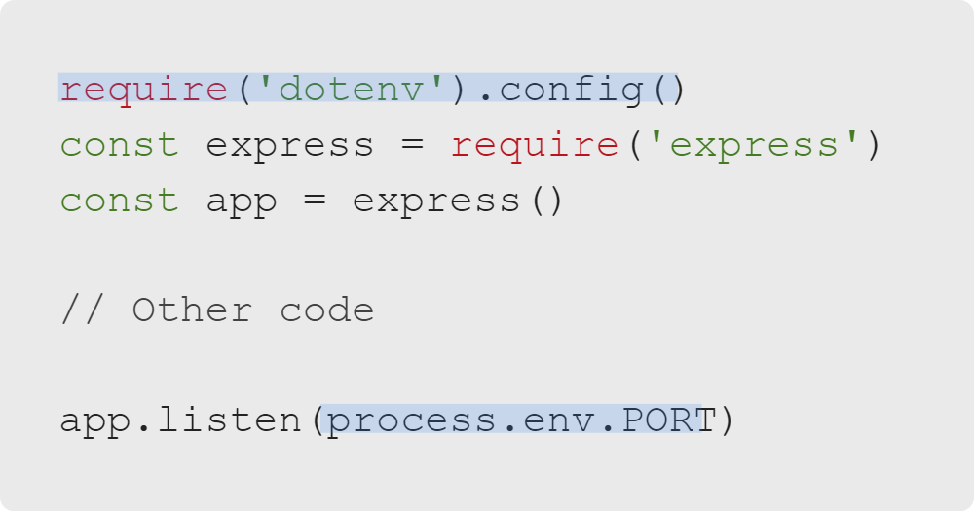
Routing: Finding Your Way Around
Using Environment Variables
.env
How do you use .env variables?
Install the node module dotenv.
Require it and call the config() method.
Access the .env variable using the global variable process.
index.js
Notes:
Note: There are other ways to include environment variables (for example, on the command line). Feel free to
teach them if you prefer, but if you are not opinionated, this method with the 'dotenv' module is probably the easiest!
Do Lesson Companion Exercises 2 and 3.

Slide 6
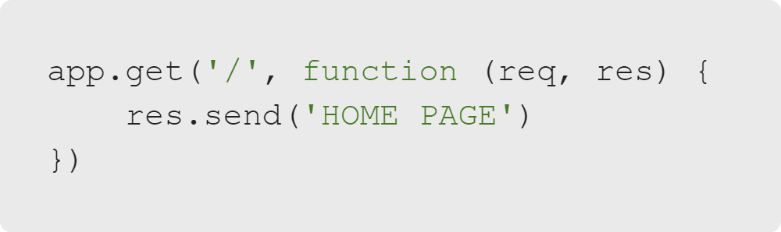
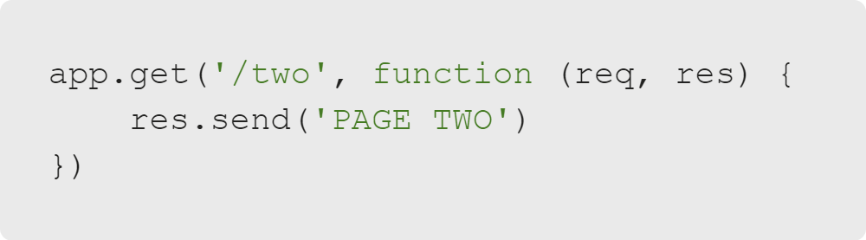
Routing: Finding Your Way Around
Making Your Second Route
We made a homepage route.
We can make another route.
Accessible via http://localhost:3000/
Accessible via http://localhost:3000/two
Notes:
Previously, we defined a homepage route by passing the path '/' to app.get().
Now, we'll make other pages to access, too.

Slide 7
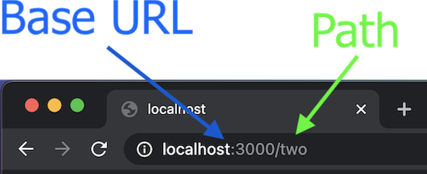
Routing: Finding Your Way Around
More Routes
Routes are defined by the path you give to app.get().
This path (/two) is added to the base URL (http://localhost:3000) to get the full address.

Slide 8
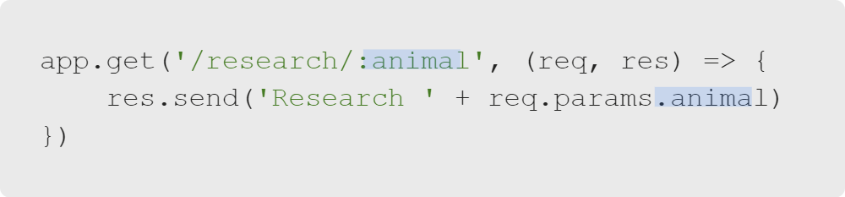
Routing: Finding Your Way Around
Query Parameters: Path Variables
A site might have pages http://example.com/research/cats, http://example.com/research/dogs, or http://example.com/research/lizards
On the server, instead of defining routes for all three pages, they could use a single route:
Notes:
In the example URL, which part of the path do you think is being interpreted as a variable, "research" or "cats"?
Do Lesson Companion Exercise 4.

Slide 9
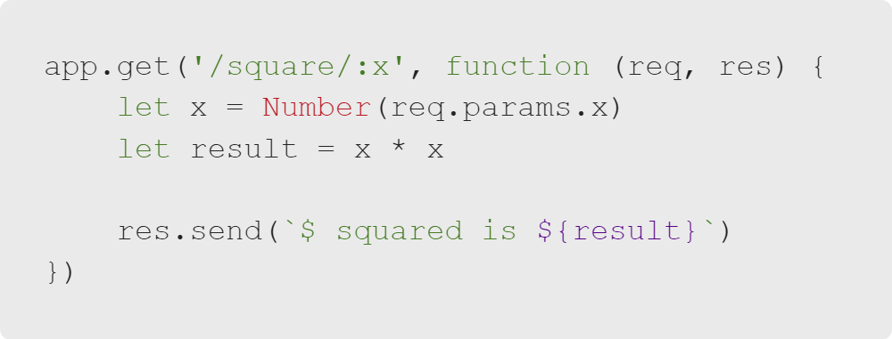
Routing: Finding Your Way Around
Query Parameters Example
Visiting the address http://localhost:3000/square/5 yields a page that states 5 squared is 25.
Visiting the address http://localhost:3000/square/8 yields a page that states 8 squared is 64.
Notes:
As you can see, we have defined several routes while only having to write one.

Slide 10
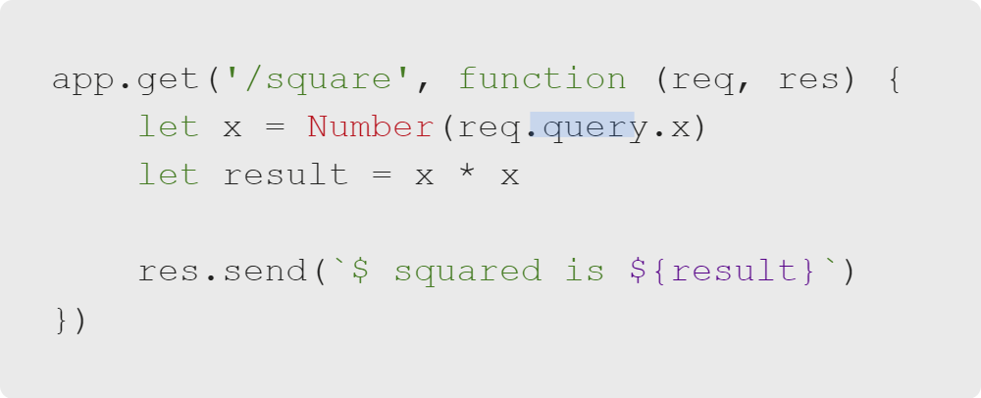
Routing: Finding Your Way Around
Query Strings
Query strings are portions of a URL that come after a question mark.
Like query parameters, query strings always contain public information. No passwords!
Here is an alternative way to write our squaring route:
We would access this page by visiting http://localhost:3000/square?x=5
Notes:
The difference is that req.query accesses the query string (after the ?).
On the other hand, req.params accesses the path itself (before the ?).
Do Lesson Companion Exercises 5 and 6.

Slide 11

Routing: Finding Your Way Around
Let's Get into It!
Now it is time to put our knowledge into practice.
Notes:
Instructor Note: Transition into the Rainbow Routes lab activity.

